Slide 1
Machine Learning Life Cycle & Semester Project

Slide 2
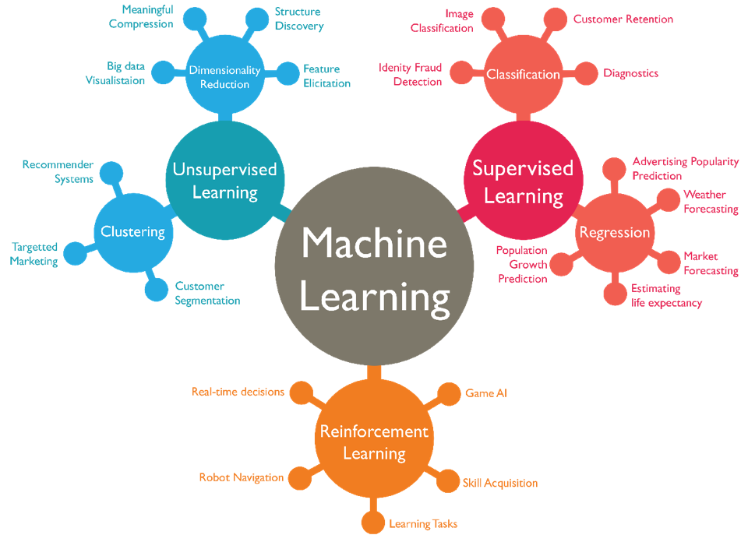
Why Use Machine Learning?

Slide 3
1.Beyond Rule-Based Systems
Traditional approaches (search algorithms, expert systems, simple agents) follow fixed rules
Limitations:
Hard to scale for complex problems
Cannot adapt to new situations
Struggle with noisy or incomplete data

Slide 4
2. Machine Learning Agents
“ML allows agents to learn from experience rather than rely on predefined rules”
Example:
Recommendation Systems: Netflix doesn’t use rules like “if user likes action, recommend all action movies” it learns preferences from user data
Self-Driving Cars: Classical agents cannot handle all traffic scenarios ML trains cars to adapt to diverse and unseen situations

Slide 5
3.ML Makes Agents Smarter
Traditional agents → fixed logic
ML-based agents → improve over time, generalize, and handle uncertainty
Key Idea: Machine Learning enables creating adaptive, intelligent systems that traditional algorithms alone cannot handle efficiently.

Slide 6
What is Machine Learning? A way for computers to learn patterns from data Makes predictions or decisions without being explicitly programmed
Why ML is Useful?
Helps solve real-world problems efficiently
Can uncover hidden patterns in large datasets
Powers applications like:
Predictive analytics (churn, sales forecasting)
Computer vision (self-driving cars, face recognition)
Natural language processing (chatbots, sentiment analysis)
Our Project Workflow
Problem Understanding → Data Gathering
Data Understanding → Preprocessing
Feature Selection & Engineering
Model Training → Validation → Testing

Slide 7
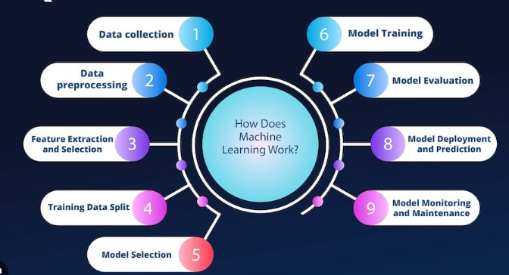
Why Use Machine Learning?

Slide 8
Data Understanding
1. Explore the Dataset
Check size, dimensions, types of features
Understand what each column represents
Identify target variable
2. Summary Statistics
Mean, median, standard deviation for numerical features
Counts and frequencies for categorical features
Detect obvious anomalies
3. Data Visualization
Histograms → see distribution of features
Boxplots → detect outliers
Scatterplots / Pairplots → relationships between features
Correlation heatmaps → which features are related
4.Identify Data Issues
Missing values
Duplicate records
Skewed or imbalanced distributions

Slide 9
Data Preprocessing
1. Handling Missing Values
Remove or fill missing values (mean, median, mode, or prediction-based)
Ensures complete dataset for modeling
2. Encoding Categorical Variables
Convert categories into numbers:
Label Encoding → for ordinal data
One-Hot Encoding → for nominal data
3. Scaling / Normalization
Standardize feature ranges to help algorithms converge faster:
StandardScaler (Z-score)
Min-Max Scaling
IQR method
4. Removing Duplicates & Outliers
Drop duplicates to avoid biased learning
Handle outliers that can skew the model

Slide 10
Feature Extraction/Engineering & Selection
Feature Extraction
Create new features from raw data to better represent the problem
Techniques:
Combining existing features (e.g., total_purchase = items × price)
Transformations (log, polynomial features)
Dimensionality reduction: PCA to capture main variance directions
Feature Selection
Choose the most important features to reduce complexity and improve performance
Techniques:
Filter methods: f_classif, correlation
Wrapper methods: recursive feature elimination
Embedded methods: Random Forest feature importance

Slide 11
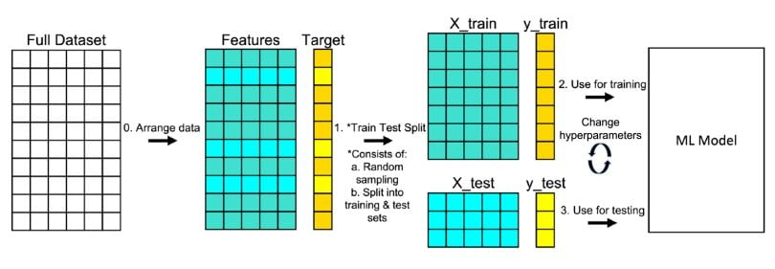
Test-Train Split

Slide 12
Train & Test:
Think of building a self-driving car system.
Train Set (Teaching the Car)
Feed the model tons of images/videos: roads, pedestrians, traffic signs.
The model learns patterns, like “this is a road,” “this is a pedestrian,” etc.
Basically, this is where it learns how the world works.
Test Set (Safety Check Before Release)
New driving scenarios the model has never seen.
Measures: accuracy, reliability, ability to handle real-world situations.
Like taking the car onto new roads to see if it really works.
Why Split?
Prevents the model from only performing well on training roads.
Ensures it can handle new environments.
Gives a trustworthy performance score.

Slide 13
Problem
While building the car, engineers tweak the model all the time:
Changing layers
Adjusting learning rates
Testing new architectures
If they check performance on the test set every time, the model starts to “cheat” → test results become unreliable.

Slide 14
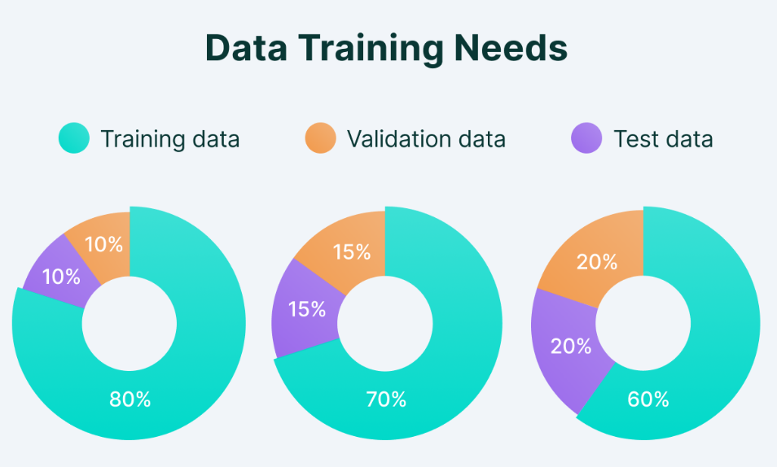
Test-Train-validation Split

Slide 15
Validation Set — The Tuning Track
A separate set of roads/scenarios used during development.
Helps decide:
Best model version
When to stop training
Which tweaks actually improve performance
Keeps the test set untouched for final honest evaluation.
Workflow
Train → Validate → Tune → Validate → Final Test
Why It Works
Test set remains unbiased.
Model generalizes better.
Engineers pick the best model confidently before release.

Slide 16
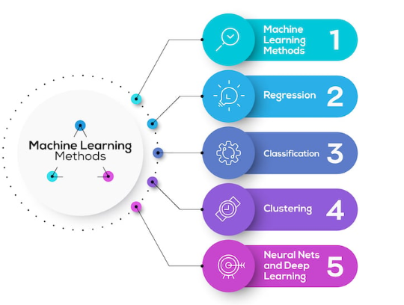
Model Training:

Slide 17
Types of Machine Learning:
1.Supervised Learning
Learn from labeled data (input → output)
Goal: Predict outcomes for new data
Examples:
Predicting house prices
Email spam detection
2. Unsupervised Learning
Learn from unlabeled data
Goal: Find patterns, clusters, or structures in data
Examples:
Customer segmentation
Anomaly detection
3. Semi-Supervised Learning
Combination of labeled and unlabeled data
Useful when labeled data is expensive
Example:
Medical diagnosis with a few labeled cases and many unlabeled patient records
4.Reinforcement Learning
Agent learns by trial and error, receiving rewards or penalties
Goal: Maximize cumulative reward in an environment
Examples:
Self-driving cars
Game-playing AI (Chess, Go)

Slide 18
Types of Supervised Learning: Requires labeled data (input → known output) Model learns the mapping from features to label Supervised learning is all about predicting known outcomes using historical data.
Regression
Predict continuous numerical values
Evaluation → Accuracy, Precision, Recall, F1-score
Examples:
Predicting house prices
Forecasting sales
Estimating temperature
Classification
Predict categorical labels
Evaluation → MSE, RMSE, MAE
Examples:
Email spam detection (spam / not spam)
Handwritten digit recognition (0–9)
Disease diagnosis (positive / negative)

Slide 19
Types of Unsupervised Learning
No labeled outputs are needed
Finds hidden patterns, structure, or outliers in the data
Key Idea: Unsupervised learning helps discover insights from raw data without explicit guidance.
1.Clustering
Group data into similar clusters without labels
Examples:
Customer segmentation for marketing
Grouping news articles by topic
Image segmentation
2.Dimensionality Reduction
Reduce number of features while retaining important information
Techniques: PCA, t-SNE, UMAP
Examples:
Visualizing high-dimensional data
Speeding up training by reducing input size
3.Anomaly Detection
Identify unusual or rare data points
Examples:
Fraud detection in banking
Fault detection in manufacturing
Network intrusion detection

Slide 20
Semi-Supervised Learning
What is Semi-Supervised Learning?
Bridges the gap between supervised and unsupervised learning
Uses a small amount of labeled data + a large amount of unlabeled data
Combines strengths of supervised and unsupervised learning
Why Use It?
Labeled data is often expensive or time-consuming to obtain
Unlabeled data is usually easy to collect
Examples
Medical diagnosis: Few labeled patient records + many unlabeled cases
Text classification: Small set of labeled articles + large corpus of unlabeled texts
Speech recognition: Limited labeled audio + massive unlabeled recordings

Slide 21
What is Reinforcement Learning?
Learning by trial and error
An agent interacts with an environment and receives rewards or penalties
Goal: maximize cumulative reward over time
Key Components
Agent: The learner or decision maker
Environment: Where the agent acts
Actions: Choices the agent can make
Rewards: Feedback signal to guide learning
Policy: Strategy for choosing actions
Examples
Self-driving cars: Learn to navigate safely in traffic
Game-playing AI: AlphaGo, Chess, Atari games
Robotics: Teaching robots to pick and place objects
RL allows AI to learn optimal strategies in dynamic, uncertain environments
Different from supervised learning no fixed “correct answer,” only feedback

Slide 22
Evaluation Methods in Machine Learning
For Supervised Learning
1.Regression Metrics (predicting numbers)
Mean Absolute Error (MAE): Average absolute difference between predicted & actual
Mean Squared Error (MSE): Average squared difference (penalizes large errors)
Root Mean Squared Error (RMSE): Square root of MSE, same units as target
R² Score: How much variance in data is explained by the model

Slide 23
Evaluation Methods in Machine Learning
For Supervised Learning
2. Classification Metrics (predicting categories)
Accuracy: Fraction of correct predictions
Precision: Correct positive predictions / all predicted positives
Recall (Sensitivity): Correct positive predictions / all actual positives
F1 Score: Harmonic mean of precision & recall
Confusion Matrix: Visual representation of True Positives, False Positives, etc.
ROC-AUC: Measures model’s ability to distinguish classes

Slide 24
Evaluation Methods in Machine Learning
For Unsupervised Learning
Clustering: Silhouette Score, Davies-Bouldin Index, Calinski-Harabasz Index
Dimensionality Reduction: Explained variance (PCA), reconstruction error (autoencoders)
Anomaly Detection: Precision, recall, F1-score for detected anomalies

